Slide 1
JOptionPane class

Slide 2
Dialog Boxes
A dialog box is a small graphical window that displays a message to the user or requests input.
A variety of dialog boxes can be displayed using the JOptionPane class.
Two of the dialog boxes are:
  Message Dialog - a dialog box that displays a message.
  Input Dialog - a dialog box that prompts the user for input.

Slide 3
Using the import Statement
The JOptionPane class is not automatically available to your Java programs.
The following statement must be before the program’s class header:
  import javax.swing.JOptionPane;
This statement tells the compiler where to find the JOptionPane class.

Slide 4
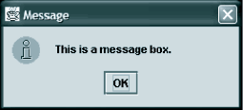
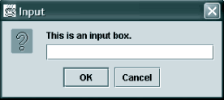
Dialog Boxes
The JOptionPane class provides static methods to display each type of dialog box.

Slide 5
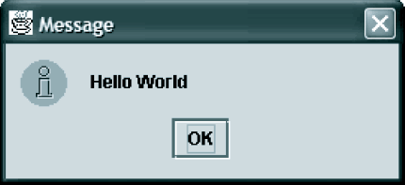
Message Dialogs
JOptionPane.showMessageDialog method is used to display a message dialog.
  JOptionPane.showMessageDialog(null, "Hello World");
The second argument is the message that is to be displayed

Slide 6
Input Dialogs
An input dialog is a quick and simple way to ask the user to enter data.
The dialog displays a text field, an Ok button and a Cancel button.
If Ok is pressed, the dialog returns the user’s input.
If Cancel is pressed, the dialog returns null.

Slide 7
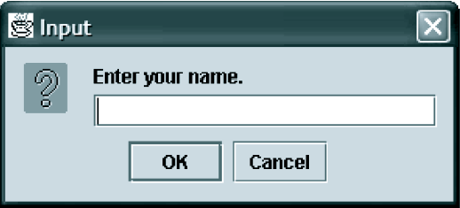
Input Dialogs
  String name;
  name = JOptionPane.showInputDialog(
  "Enter your name.");
The argument passed to the method is the message to display.
If the user clicks on the OK button, name references the string entered by the user.
If the user clicks on the Cancel button, name references null.

Slide 8
NamesDialog.java
import javax.swing.JOptionPane;
public class NamesDialog
{
public static void main(String[] args)
{
String firstName; // The user's first name
String middleName; // The user's middle name
String lastName; // The user's last name
// Get the user's first name
firstName =
JOptionPane.showInputDialog("What is " +
"your first name? ");

Slide 9
NamesDialog.java
// Get the user's middle name.
middleName =
JOptionPane.showInputDialog(
"What is " + "your middle name? ");
// Get the user's last name.
lastName =
JOptionPane.showInputDialog("What is " + "your last name? ");

Slide 10
Example
// Display a greeting
JOptionPane.showMessageDialog(null, "Hello " + firstName + " " +middleName + " " + lastName);
System.exit(0);
}
}

Slide 11
The System.exit() Method
A program that uses JOptionPane does not automatically stop executing when the end of the main method is reached.
Java generates a thread, which is a process running in the computer, when a JOptionPane is created.
If the System.exit method is not called, this thread continues to execute.

Slide 12
The System.exit() Method
The System.exit method requires an integer argument.
  System.exit(0);
This argument is an exit code that is passed back to the operating system.
This code is usually ignored, however, it can be used outside the program:
  to indicate whether the program ended successfully or as the result of a failure.
  The value 0 traditionally indicates that the program ended successfully.

Slide 13
Converting a String to a Number
The JOptionPane’s showInputDialog method always returns the user's input as a String
String containing a number, such as “127.89, can be converted to a numeric data type.

Slide 14
The Parse Methods
Parse methods convert strings to numeric data types
They are:
  Byte.parseByte
  Integer.parseInt
  Short.parseShort
  Long.parseLong
  Float.parseFloat
  Double.parseDouble

Slide 15
The Parse Methods- Examples
byte bVar = Byte.parseByte("1");
int iVar = Integer.parseInt("2599");
short sVar = Short.parseShort("10");
long lVar = Long.parseLong("15908");
float fVar = Float.parseFloat("12.3");
double dVar = Double.parseDouble("7945.6");

Slide 16
PayrollDialog.java
import javax.swing.JOptionPane;
public class PayrollDialog
{
public static void main(String[] args)
{
String inputString; // For reading input
String name; // The user's name
int hours; // The number of hours worked
double payRate; // The user's hourly pay rate
double grossPay; // The user's gross pay

Slide 17
PayrollDialog.java
// Get the user's name.
name = JOptionPane.showInputDialog("What is " + "your name? ");
// Get the hours worked.
inputString =
JOptionPane.showInputDialog(
"How many hours” +
“ did you work this week? ");
// Convert the input to an int.
hours = Integer.parseInt(inputString);

Slide 18
PayrollDialog.java
// Get the hourly pay rate.
inputString =
JOptionPane.showInputDialog("What is” + " your hourly pay rate? ");
// Convert the input to a double.
payRate = Double.parseDouble(inputString);
// Calculate the gross pay.
grossPay = hours * payRate;

Slide 19
PayrollDialog.java
// Display the results.
JOptionPane.showMessageDialog(null, "Hello " + name + ". Your gross pay is $" + grossPay);
// End the program.
System.exit(0);
}
}

